Slide 1
Chapter 8: Main Memory (2)
Apr, 2024

Slide 2
Chapter 8: Memory Management
Paging
Basics
Implementation
Virtual address translation
Improvement of paging
TLB
two-level paging

Slide 3
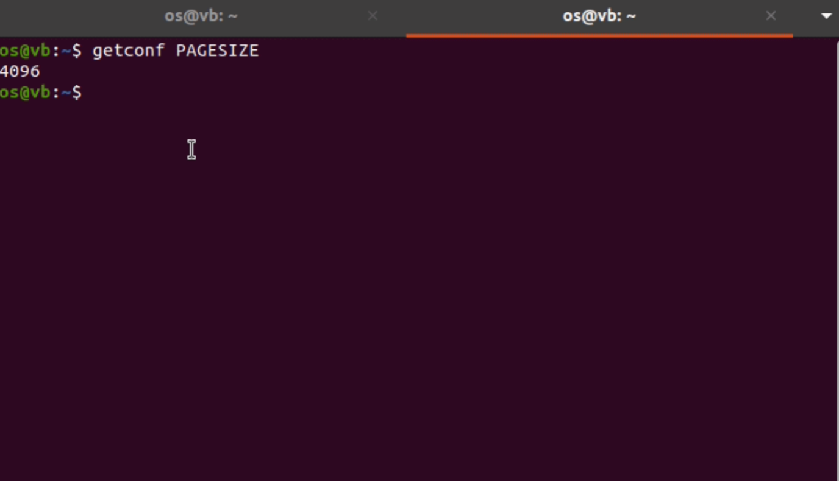
Page Size
Notes:
每个page的大小为4KB

Slide 4
Paging: Basics

Slide 5
Paging
Divide physical memory into fixed-sized blocks called frames
Size is power of 2
Divide logical memory into blocks of same size called pages（一般为4KB）
Notes:
getconf PAGESIZE

Slide 6
Pages and Frames
VA
PA
page
frame

Slide 7
VA-PA mapping
Physical memory layout

Slide 8
Implementation of Paging

Slide 9
How to do paging
Keep track of all free frames（free frames list）
To run a program of size N pages, need to find N free frames and load program
Set up a page table to translate logical to physical addresses

Slide 10
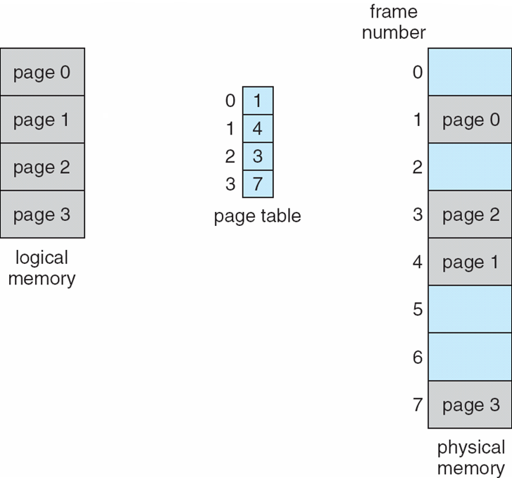
Page Table
page number
frame number

Slide 11
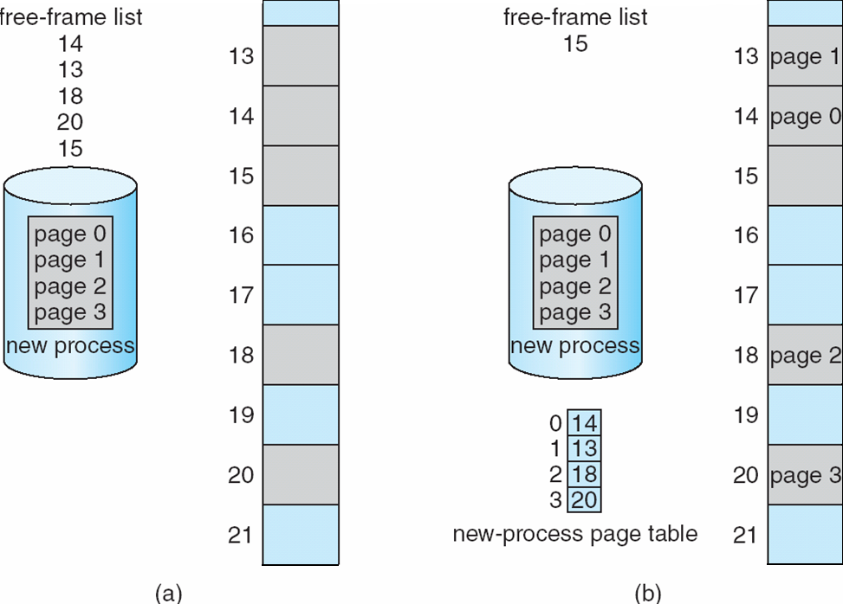
A Paging Example
Before allocation
After allocation
Notes:
Blue: used
Grey: free
Allocation是在load期间进行的，这期间生成了page table

Slide 12
Page table is per process!!!
而且要维护一个完整的mapping，
不只是使用到的page-frame对应

Slide 13
How to do translation

Slide 14
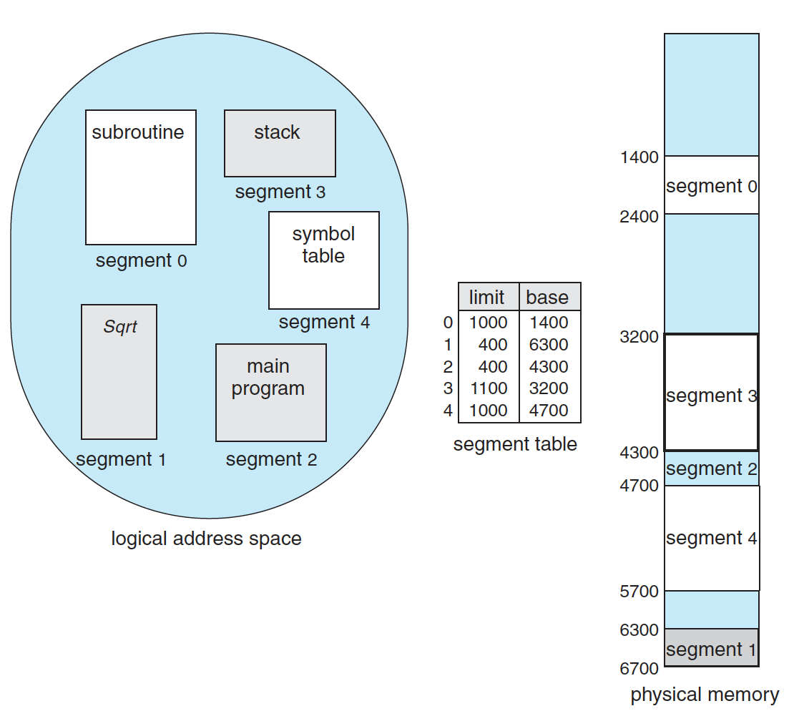
Recall Segmentation
<001, 000000011011>_{b}
<2, 1FF>_{h}
<3, 00F>_{h}
Notes:
Segment num + offset

Slide 15
Virtual Address
Address generated by CPU is divided into:
Page number (p) – used as an index into a page table which contains base address of each page in physical memory
Page offset (d) – combined with base address to define the physical memory address that is sent to the memory unit
For given logical address space 2^{m} and page size 2^{n}
Notes:
如果是10进制，除法，分别取商（page num）和余数（offset），效果等同二进制中的移位。对于物理地址也是适用的

Slide 16
Physical Address
Physical address is divided into:
frame number (f)
frame offset (d)
Frame number | Frame offset

Slide 17
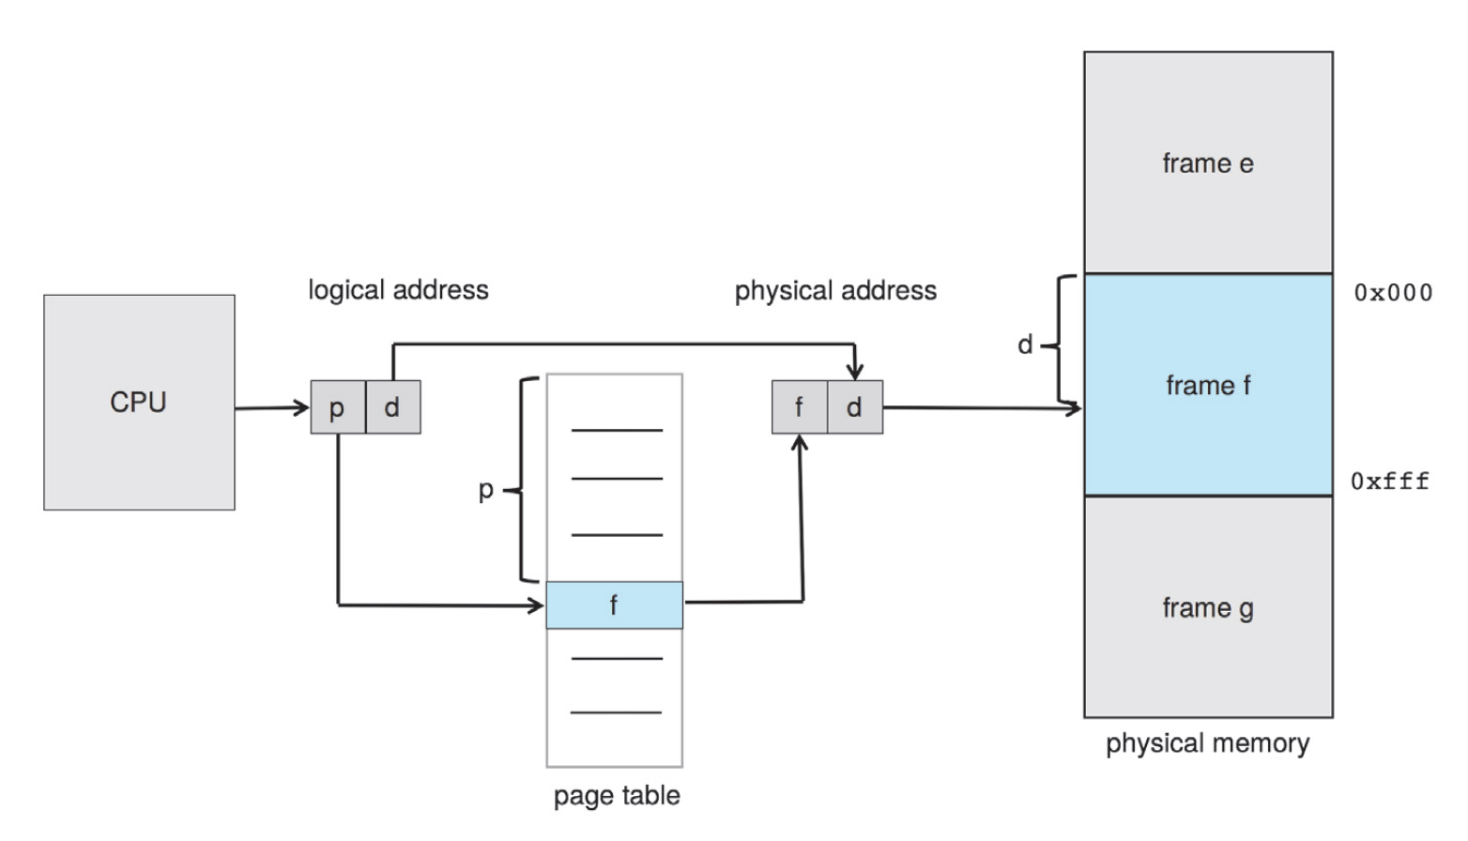
Translation in Paging

Slide 18
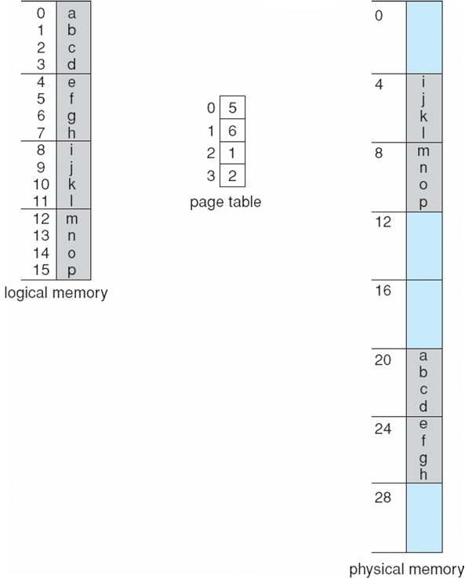
Paging Example
0
1
2
3
16-byte virtual memory and 4-byte pages: 4 pages
0
1
2
3
4
5
6
7
Example:
32-byte physical memory and 4-byte pages: 8 frames
Virtual address
Physical address
Read the data stored
at V.A. 13: 1101_{b}
Read the data stored
at V.A. 6: 0110_{b}
Notes:
页表扩大寻址能力
两种方式计算地址翻译：
10进制度：除法，商是number，余数是offset
2进制：像机器一样分为前后两部分，前面是page number，后面是offset：
比如1101，这里的page size为4，所以后两位是offset 1，前两位是page num 3，刚好是第13个

Slide 19
Summary: Virtual address
Contiguous
Logical address
Segmentation
<segment number, segment offset>
Paging
<page number, page offset>

Slide 20
Summary: VA to PA
Contiguous
base + limit
Segmentation
Segment table
Va: <#seg, offset>
Paging
Page table
Va: <#page, offset>
seg# | base | limit
In memory
Per process
page# | frame#

Slide 21
Improvement of Paging

Slide 22
Paging: Pros and Cons
Advantage
Avoids external fragmentation
Problems
Internal fragmentation
Double memory access（TLB）
Page table size（huge table）（Hierarchical page table）

Slide 23
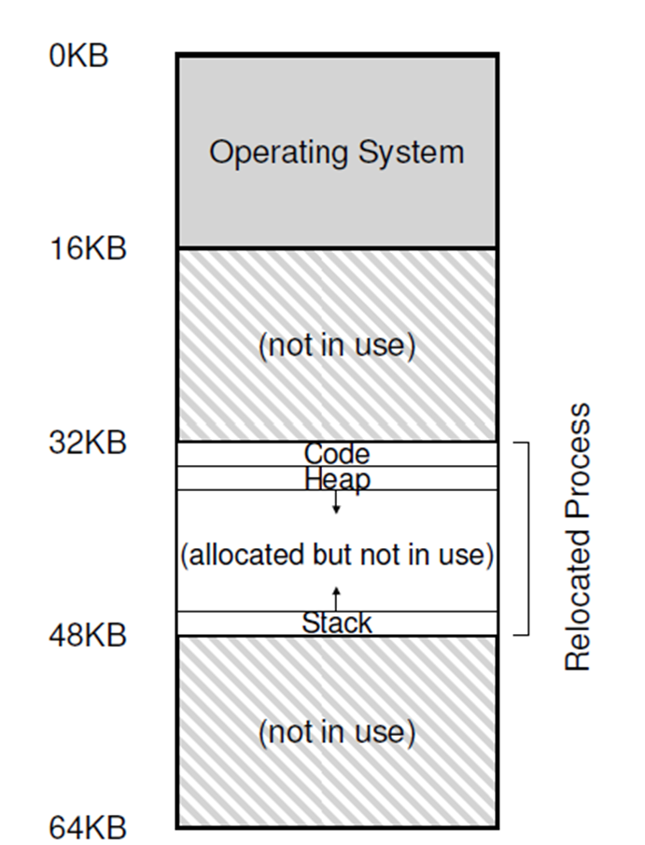
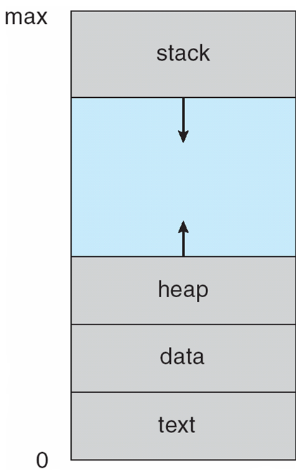
Internal fragmentation
Internal Fragmentation – allocated memory may be slightly larger than requested memory; this size difference is memory internal to a partition, but not being used
VA
contiguous
Notes:
Small page size?

Slide 24
Internal fragmentation
Calculating internal fragmentation
Page size = 2,048 bytes
Process size = 72,766 bytes
35 pages + 1,086 bytes
Internal fragmentation of 2,048 - 1,086 = 962 bytes
Worst case fragmentation = 1 frame – 1 byte
On average fragmentation = 1 / 2 frame size
So small frame sizes desirable?

Slide 25
Double Memory Access
Hardware device that at run time maps virtual to physical address
VA
PA
CPU
MMU
Memory
DATA

Slide 26
Double Memory Access
Hardware device that at run time maps virtual to physical address
VPN
VA
PFN
CPU
MMU
Memory
PA
DATA
Page table is kept in memory!!
Notes:
每一次地址访问都要访问两次内存，
一次是通过PTBR（page-table base register，指向page table的寄存器）访问page table以获取frame num，
一次是知道了frame num并计算出PA后真正访问那个物理地址

Slide 27
Performance of Various Levels of Storage

Slide 28
Hardware Solution
The two memory access problem can be solved by the use of a special fast-lookup hardware cache called associative memory or translation look-aside buffers (TLBs)
TLB is a cache in MMU
of page table in memory!!!

Slide 29
TLB
Virtual page number
Physical frame number
VPN
PPN (PFN)
Notes:
Tlb per process?
ASID（address space id）：唯一标识每个进程，提供地址空间的保护。确保当前进程的ASID与TLB中page的ASID匹配，若不匹配则作为TLB miss
PCID

Slide 30
MMU & Paging & TLB
Hardware device that at run time maps virtual to physical address
TLB
VPN
PFN
VA
PA
Memory
CPU
MMU
DATA

Slide 31
TLB Miss
Hardware device that at run time maps virtual to physical address
TLB
VPN
PFN
Memory
VA
VPN
CPU
MMU
PA
DATA
Notes:
MMU先从TLB中查找VPN，这里没有找到，再通过PGBR从内存中的pagetable中寻找VPN，如果再没找到就是page fault，找到了返回给PFN计算PA

Slide 32
TLB hit or miss: hardware support!!!
TLB miss可能由硬件自动处理或
通过OS的interrupt处理
Notes:
May be operating system?!

Slide 33
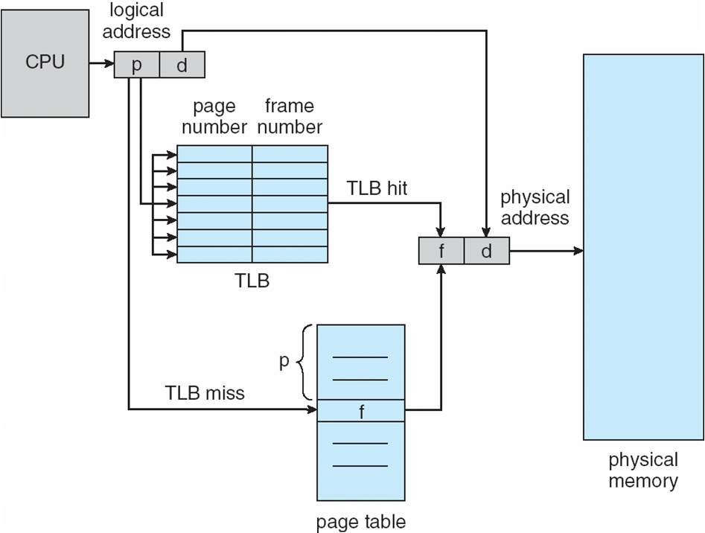
Paging Hardware With TLB
Notes:
Logical address 由 page number 和 offset 组成

Slide 34
Effective Access Time
TLB lookup = ε time unit
Can be < 10% of memory access time
Hit ratio = α
Hit ratio – percentage of times that a page number is found in TLB

Slide 35
Effective Access Time
Effective Access Time (EAT)
ε: TLB access time: negligible
t: memory access time
α: hit ratio
Hit则一次内存访问，miss则两次
（不考虑TLB访问时间的情况下）
EAT = tα + 2t(1 – α)
Consider α = 80%, 100ns for memory access
EAT = 0.80 x 100 + 0.20 x 200 = 120ns
Consider more realistic hit ratio: α = 99%, 100ns for memory access
EAT = 0.99 x 100 + 0.01 x 200 = 101ns
Notes:
EAT = (t + ε) α + (2t + ε)(1 – α)
EMAT = h*(c+m) + (1-h)*(c+2m) where, h = hit ratio of TLB m = Memory access time c = TLB access time

Slide 36
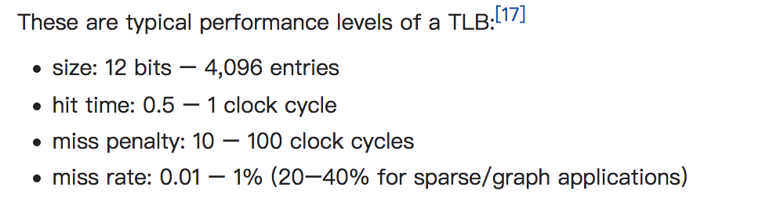
Typical TLB
https://en.m.wikipedia.org/wiki/Translation_lookaside_buffer
Notes:
sudo sh -c ‘echo -1 > /proc/sys/kernel/perf_event_paranoid’
sudo perf stat -e dTLB-loads,dTLB-load-misses,iTLB-loads,iTLB-load-misses -p pid

Slide 37
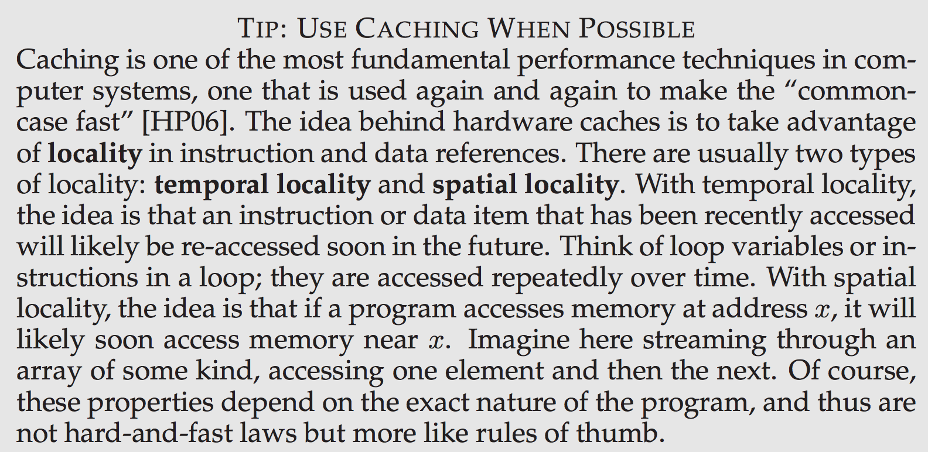
Locality

Slide 38
Paging Problem: huge table
32bit address space:
2³² - 1

Slide 39
Paging Problem: huge table
Consider a 32-bit logical address space as on modern computers
Page size of 4 KB (2¹²)
Page table would have 1 million entries (2³² / 2¹²)
If each entry is 4 bytes -> 4 MB of physical address space memory for page table alone
Page tables must be
contiguous in memory
for efficient indexing

Slide 40
Paging Problem: huge table
Consider a 32-bit logical address space as on modern computers
Page size of 4 KB (2¹²)
Page table would have 1 million entries (2³² / 2¹²)
If each entry is 4 bytes: 4 MB of physical address space memory for page table alone
That amount of memory used to cost a lot
Page tables are per process
64-bit even worse

Slide 41
Huge Table Problem
Small page size?
Table becomes larger
TLB hit ratio drops
Larger page size？
Smaller table
TLB hit ratio high
Read disk less frequently

Slide 42
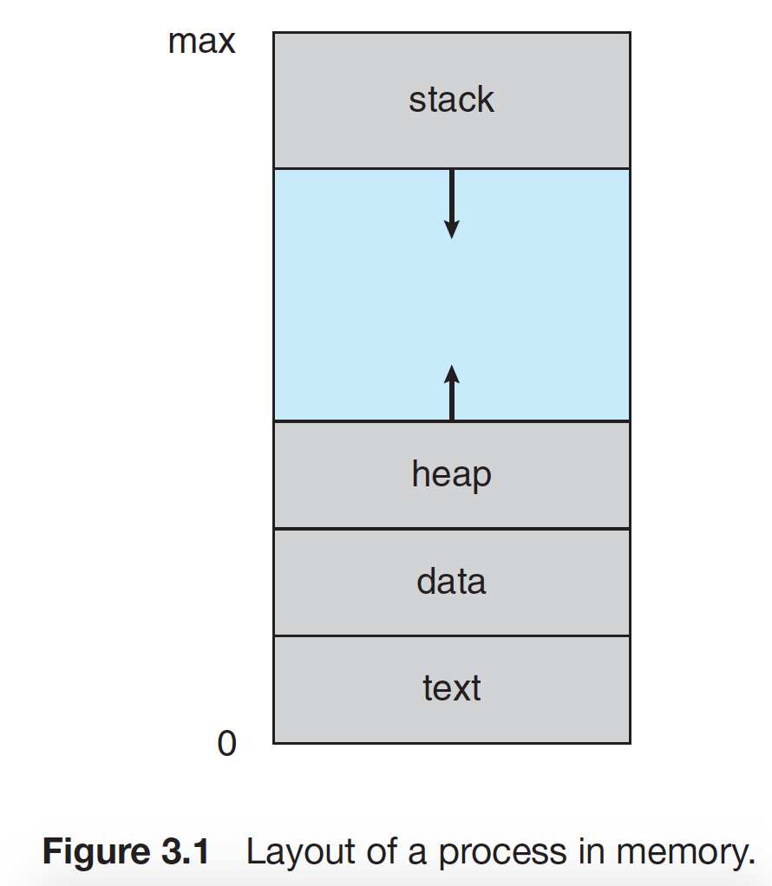
Solution
Not used virtual page has empty page table entry!
NOT USED
Do not store empty page table entry!
So page table is not contiguous!

Slide 43
Hierarchical Page Tables
Break up the logical address space into multiple page tables: break up page table
A simple technique is a two-level page table
We then page the page table（将页表再分页）

Slide 44
Two-Level Paging Example
A logical address (on 32-bit machine with 4K page size) is divided into:
a page offset consisting of 12 bits
a page number consisting of 20 bits
PTE (4B)
…
PTE (4B)
Empty
…
Empty
A page
1K*4B = 4KB
2²⁰
^{= 1K * 1K}
Notes:
页表的每个entry是4B，我们将1K个（2^10）entries作为一个二级page，

Slide 45
Two-Level Page Table
PTE
Empty
Empty
Empty
Empty
Empty
Empty
Empty
Empty
Frame
PTE
Empty
Empty
PTE
Outer page table
Page table
Physical memory
Notes:
这样，没有任何mapping（empty）的outer page就可以不开辟它对应的那1K个 entries 的空间

Slide 46
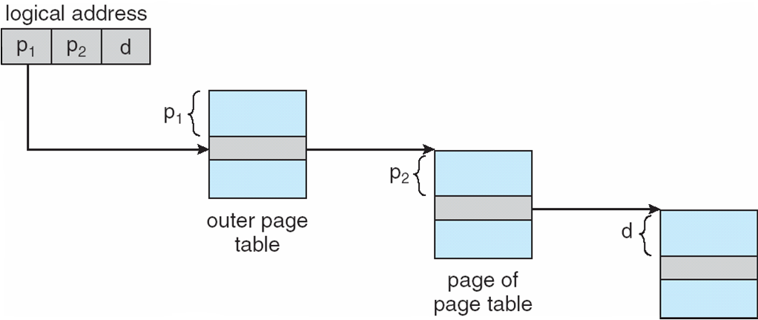
Address-Translation Scheme
Physical frame

Slide 47
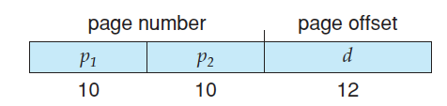
Two-Level Paging Example
A logical address (on 32-bit machine with 4K page size) is divided into:
a page offset consisting of 12 bits
a page number consisting of 20 bits
Since the page table is paged, the page number is further divided into:
a 10-bit page number
a 10-bit page offset
Thus, a logical address is as follows:

Slide 48
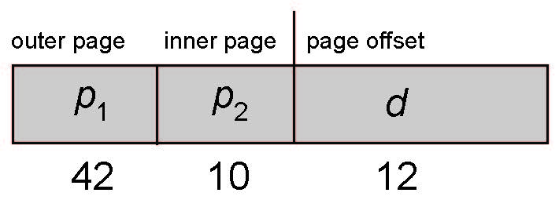
64-bit Logical Address Space
Even two-level paging scheme not sufficient
If page size is 4 KB (2¹²)
Then page table has 2⁵² entries
If two level scheme, inner page tables could be 2¹⁰
4-byte entries
Address would look like

Slide 49
64-bit Logical Address Space
Outer page table has 2⁴² entries or 2⁴⁴ bytes
One solution is to add a 2nd outer page table
But in the following example the 2nd outer page table is still 2³⁴ bytes in size
And possibly 4 memory access to get to one physical memory location
Notes:
二级page table的memory access：
要用3次内存访问才能访问到一个physical address，
第一次是根据PGBR访问二级页表，偏移量是outer page num，第二次是根据二级page上偏移量为inner page num定位到一级页表，第三次是根据一级页表和page offset找到对应的frame地址。

Slide 50
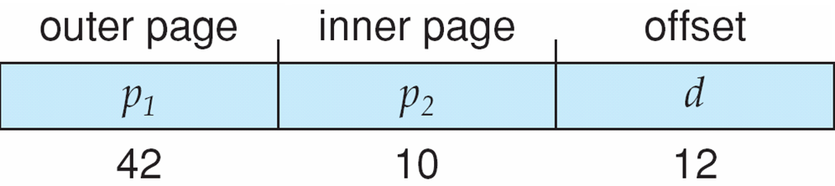
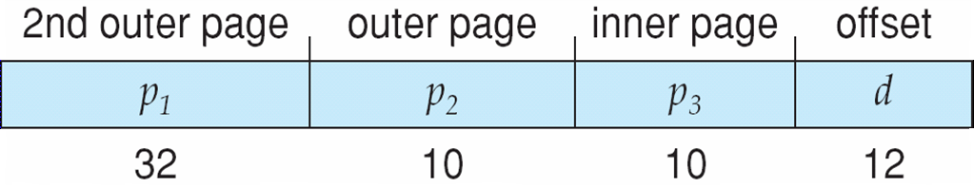
Three-level Paging Scheme

Slide 51
Summary
Paging is the most popular memory management mechanism in modern operating systems
Pages, frames, page table
No external fragmentation, but (small) internal
TLB for reduce effective memory access time
Hierarchical paging for reduce memory cost

Slide 52
Other Issues

Slide 53
Memory Protection
Memory protection implemented by associating protection bit with each frame to indicate if read-only or read-write access is allowed
Can also add more bits to indicate page execute-only, and so on
Any violations result in a trap to the kernel

Slide 54
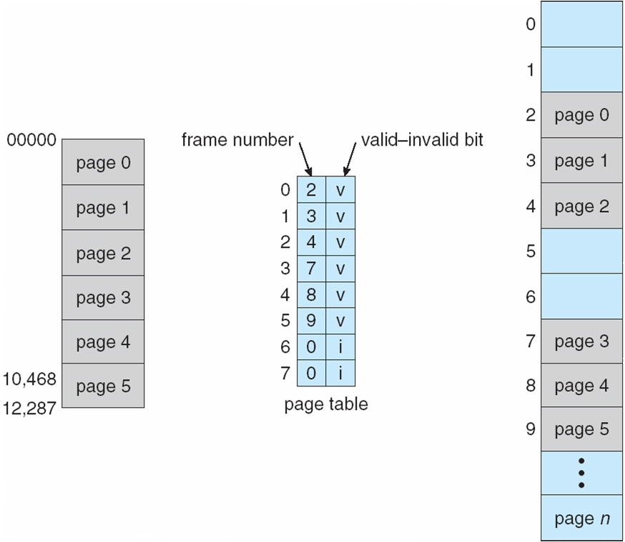
Protection Bit In A Page Table
read only?

Slide 55
Shared Pages
Shared code
One copy of read-only (reentrant 可重入) code shared among processes (i.e., text editors, compilers, window systems)
Similar to multiple threads sharing the same process space
Also useful for inter-process communication if sharing of read-write pages is allowed
Notes:
Reentrant code是不能自我修改的代码，它在执行期间不会改变。

Slide 56
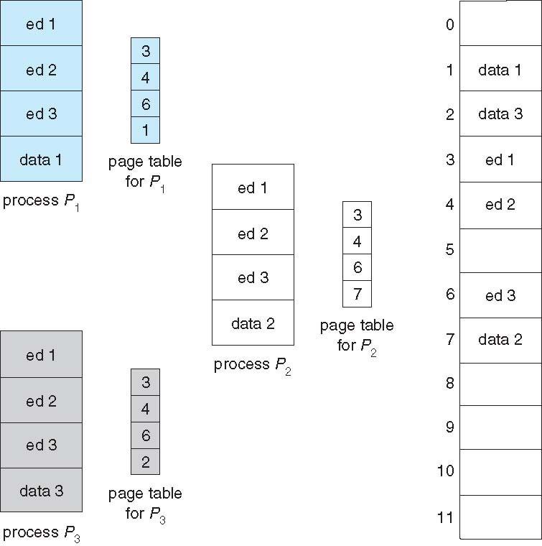
Shared Pages Example
Notes:
每个进程reentrant code的page映射到相同的frame，但是data 区要映射到不同部分，因为里面有一些初始化或者未初始化的全局变量、static

Slide 57
The End of Chap 8

